Slide 1
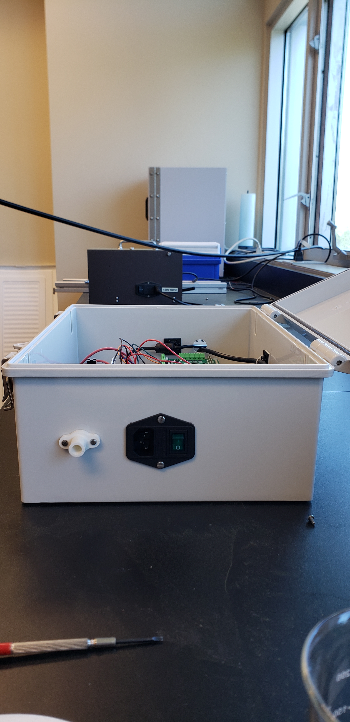
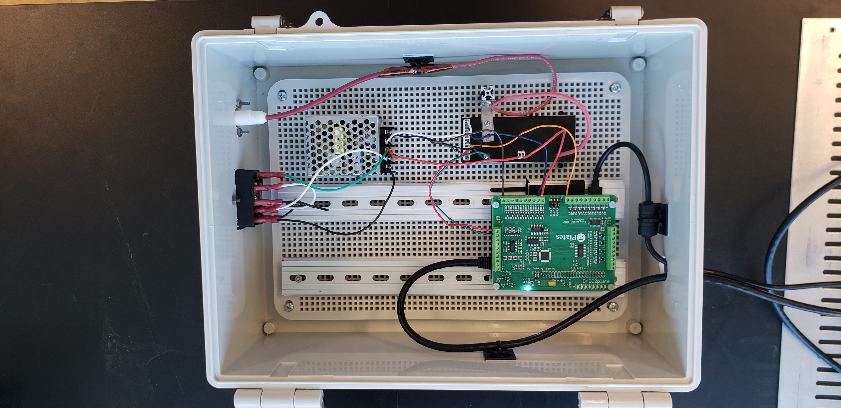
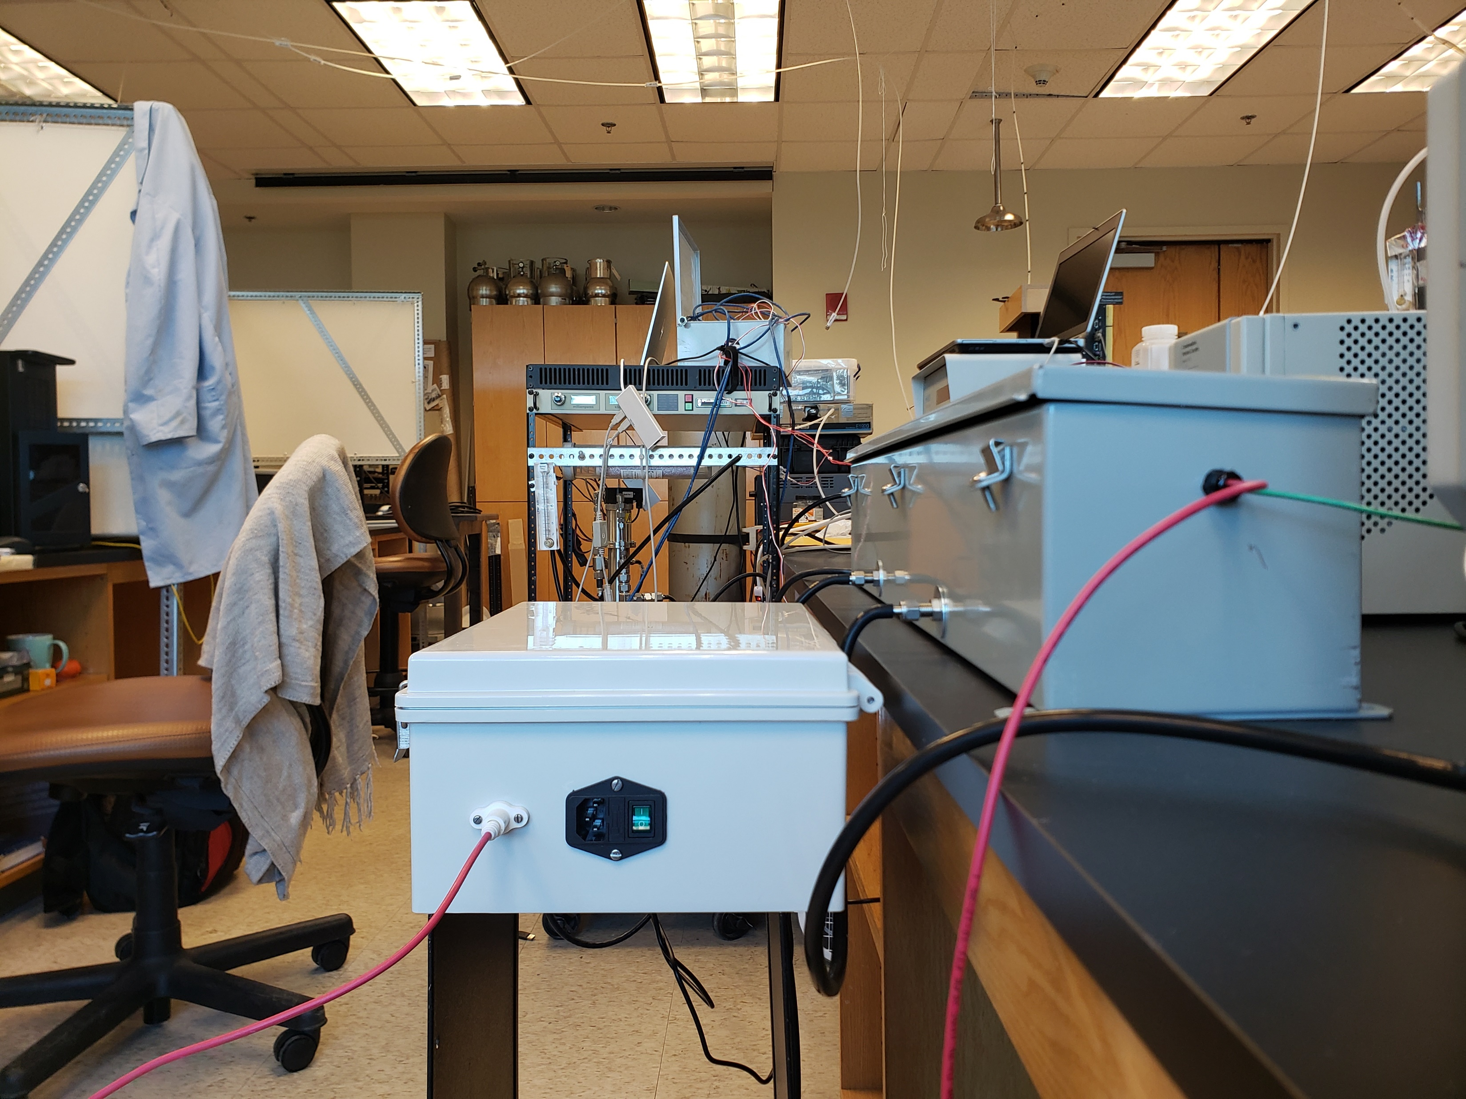
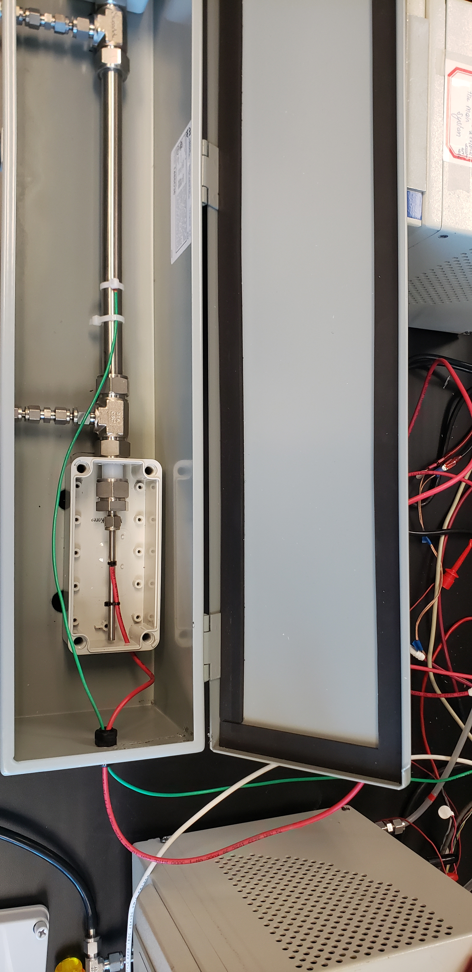
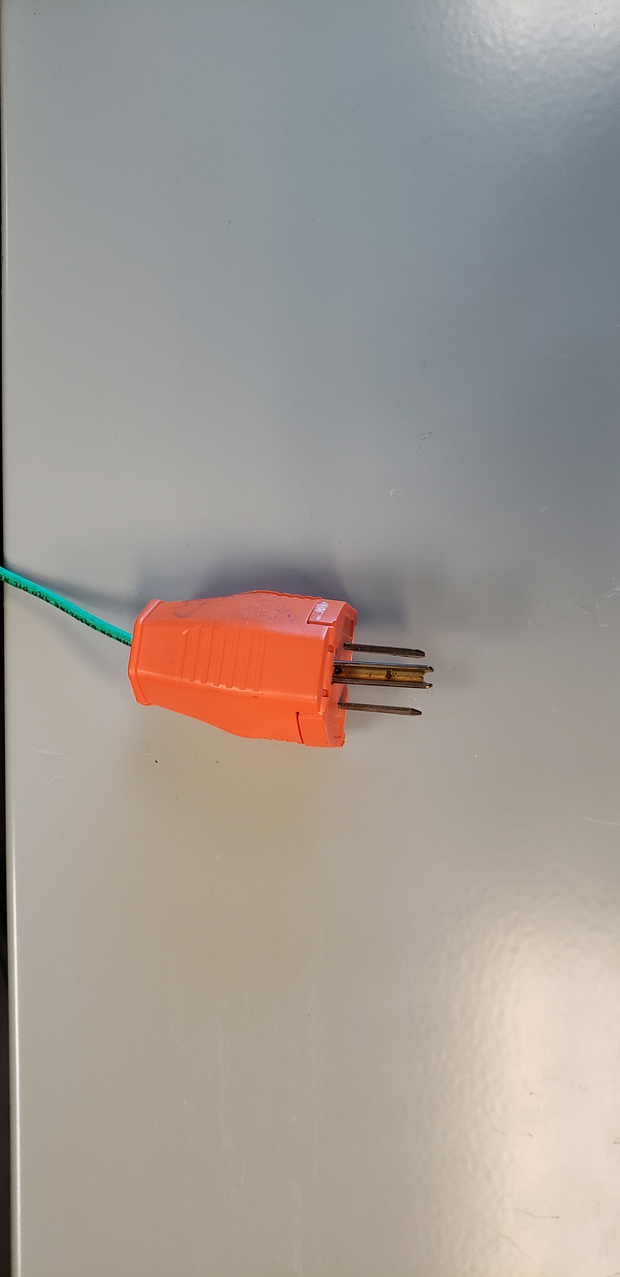
8
6
Emergency green button
5
14
1 (bottom)
7
2
15
14
6
5
(GW)
14
16
6
14
17
(HV)
(HV)
17
3
4
14
9
13
14
13
(GW)
18
11&12
(PGW)
16
10&12
9
19
(HV)
HV: Connection of High-voltage cable (HV) to inner rod of EP.
GW: Connection of the ground wire of the EP.
PGW: Plug for ground wire (GW), the biggest pin should be used for grounding wire.

